Slide 1


Explanation of Backpropagation Algorithm
20127318 – Phan Trí Tài

Slide 2
Table of contents
01
02
03
04
Fundamental concepts
Key steps
Essential mathematical formulas
Accompanied by a simple example

Slide 3

01
Fundamental concepts

Slide 4
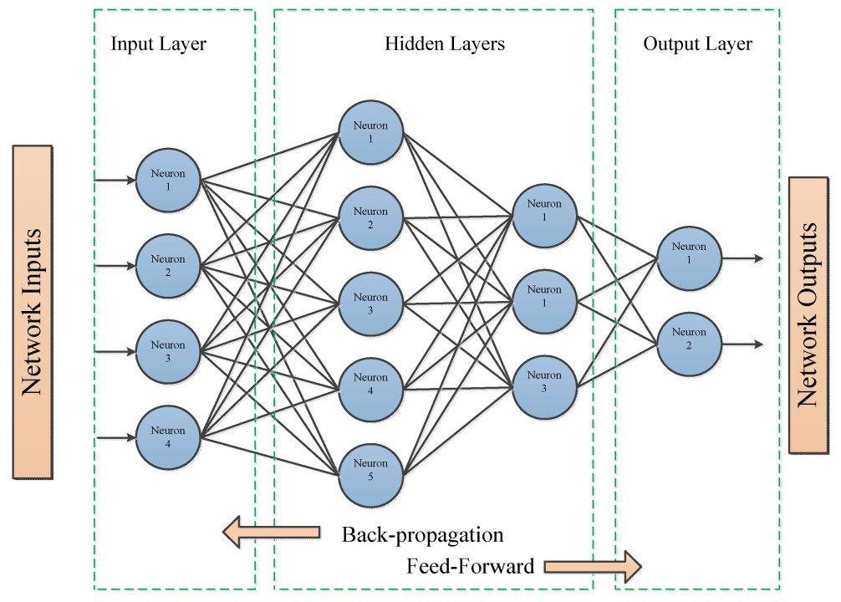
Backpropagation is an iterative algorithm, that helps to minimize the cost function by determining which weights and biases should be adjusted.

Slide 5
02
Key steps

Slide 6
Illustration of the backpropagation algorithm
Two inputs X1 and X2
Two hidden layers N1X and N2X, where X takes the values of 1, 2 and 3
One output layer

Slide 7
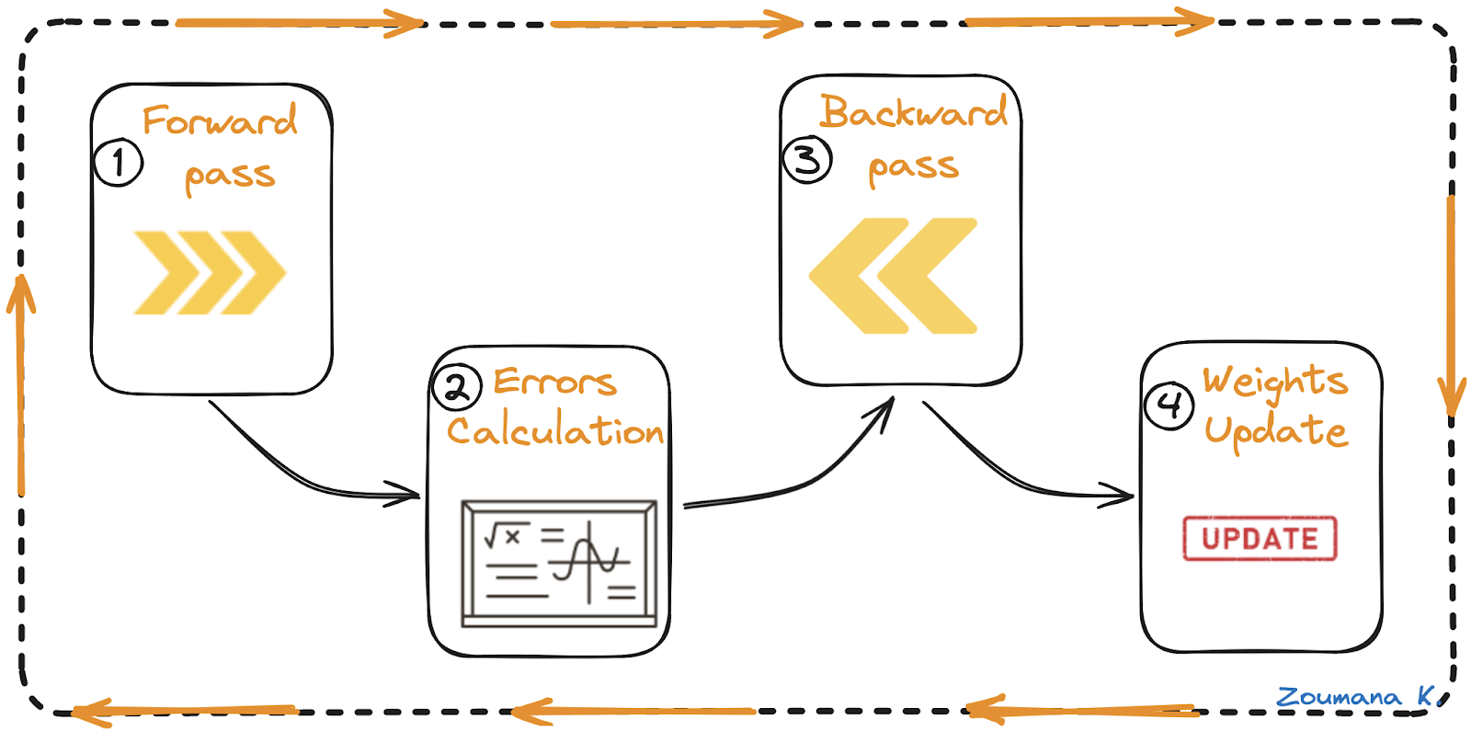
Four main steps in the backpropagation algorithm

Slide 9
03
Essential mathematical formulas

Slide 10

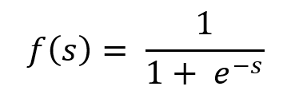
Sum of product (s):
Sigmod (output layer):

Slide 11

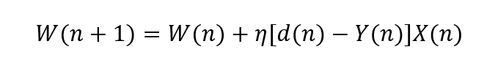
Error function:
Parameters update equation

Slide 12
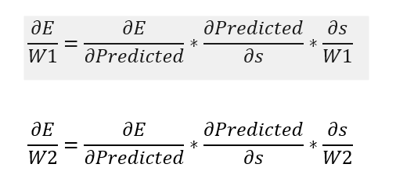
The derivative of the error W.R.T the weights:

Slide 13
04
Accompanied by a simple example

Slide 14
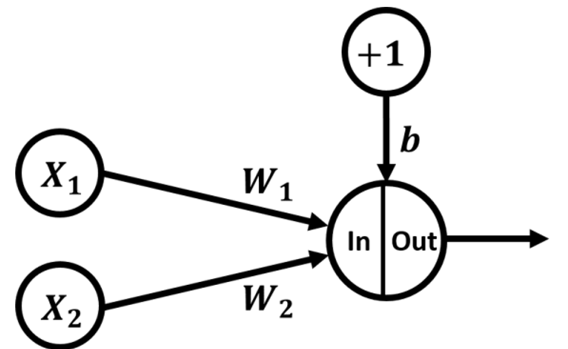

Slide 15
Example
X1 | 0.1
X2 | 0.3
W1 | 0.5
W2 | 0.2
b (bias) | 1.83
Desired Output | 0.03

Slide 16
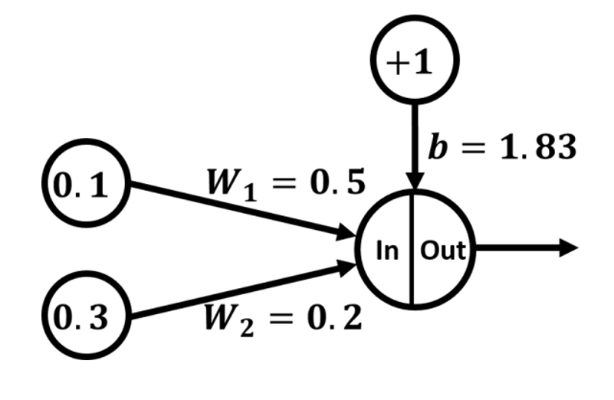

Slide 17
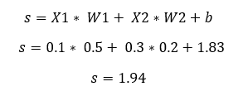
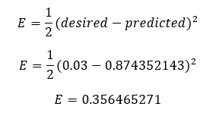
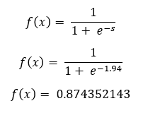
Forward pass

Slide 18
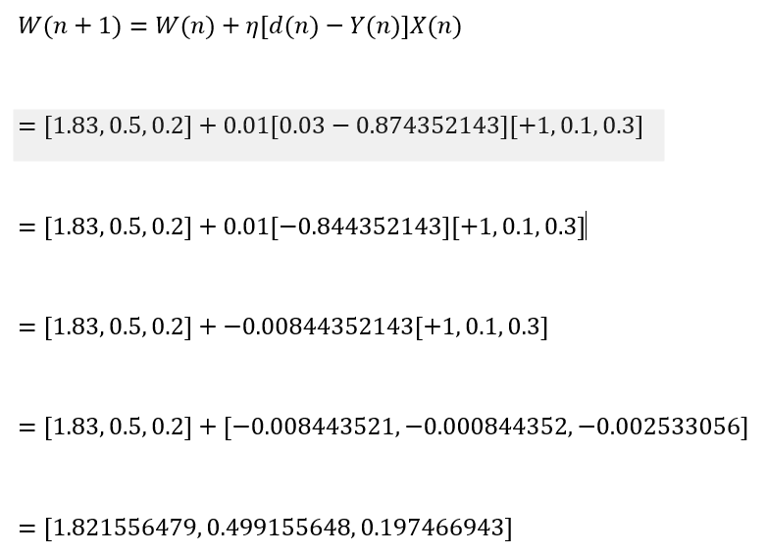
Error Calculation
Parameters update equation
W1 new | 0.197466943
W2 new | 0.499155648
b new | 1.821556479

Slide 19
Error Calculation
Update our network parameters
W1 new | 0.197466943
W2 new | 0.499155648
b new | 1.821556479

Slide 20
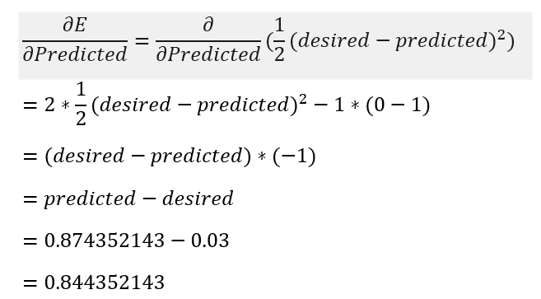
Error Calculation
For the derivative of the error W.R.T the predicted output:

Slide 21
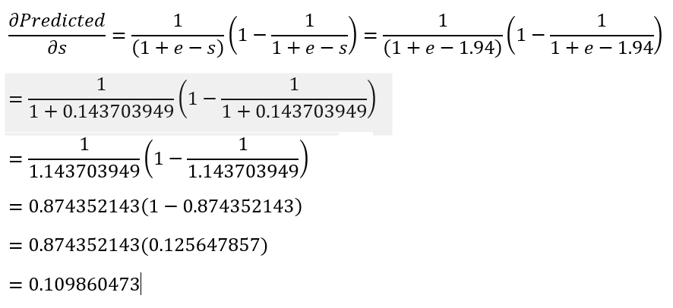
Error Calculation
For the derivative of the predicted output W.R.T, SOP:

Slide 22
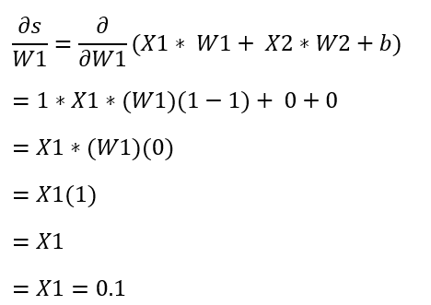
Error Calculation
For the derivative of SOP W.R.T W1:

Slide 23
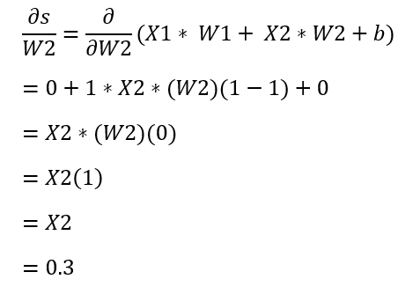
Error Calculation
For the derivative of SOP W.R.T W2:

Slide 24
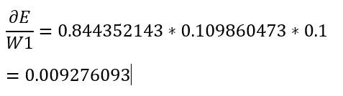
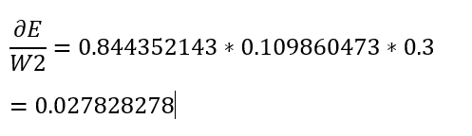
Error Calculation
For the derivative of the error W.R.T W1
For the derivative of the error W.R.T W2

Slide 25
Backward pass
Because the result of the ∂E/W1 derivative is positive, this means if W1 increases by 1, then the total error increases by 0.009276093.
Because the result of the ∂E/W2 derivative is positive, this means that if W2 increases by 1 then the total error increases by 0.027828278.

Slide 26
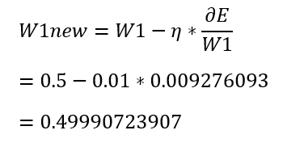
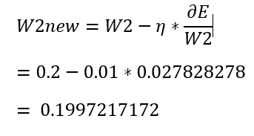
Updating weights
For W1
For W2

Slide 27
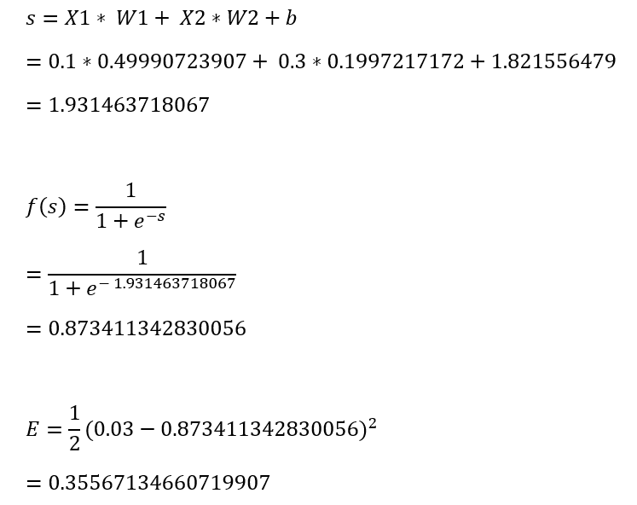
The new forward pass calculations

Slide 28
Result
When comparing the new error (0.35567134660719907) with the old error (0.356465271), there’s a reduction of 0.0007939243928009043. As long as there’s a reduction, we’re moving in the right direction.
The error reduction is small because we’re using a small learning rate (0.01)

Slide 29
Thanks

